Slide 1
Game Development 2B
Linked Lists

Slide 2

The problem with arrays
Language defined – no custom structure
Good for having random access to set elements
Searching is slow (worst case O(n) because visit every element)
Sorted more efficient
Insertions and deletions mean making or removing array spaces - slow

Slide 3
Linked lists
Collection of nodes
Each node is linked to a successor node – the next node in the list
Arrays reference by index
Linked Lists reference by relative position to other nodes
Moving through means following the links

Slide 4

referencing
How do we reference Bread if this was an array?
How do we reference Bread if we can’t use array indices?

Slide 5
Starting and ending the list
We need something to demarcate the start of the list
Header node
The end of the list will just point to null – that’s how we know it’s the end
Can also have a tail node

Slide 6

insertion
Very efficient
Redirect a pointer somewhere in the list to point to the new item
Have the new item point to the old “next” item

Slide 7

deletion
Find the item you want to delete
Point the previous item’s next pointer to the deleted item’s next pointer
Set the deleted item’s next pointer to null

Slide 8
Linked lists over arrays
Ease of insertion and deletion
1
Traversal and searching still quite slow
2
Object linked lists can easily store all types of data
3
More object oriented approach
4
Linked Lists have no max size
5

Slide 9
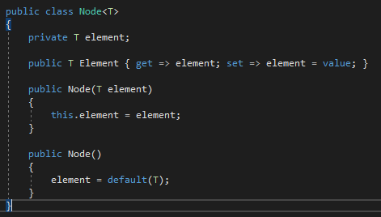
The node class
Consider our existing generic Node
What do we need to add to this to create a LinkedList node?
We have 2 constructors – an empty node and a valued node
What about linking?

Slide 10
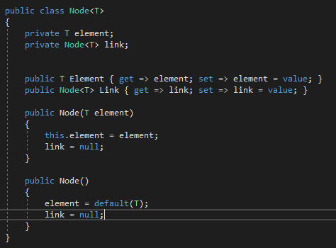
The node class

Slide 11
The linkedlist class
What is the first element needed in a LinkedList when it is constructed?
Given that our list is generic, how would we demarcate this element in comparison to other elements?

Slide 12
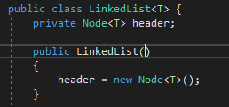
The linkedlist class

Slide 13
Pseudocode exercise
Write
Write Pseudocode on paper/PC for the following functions
Consider
Consider how one traverses through the list
Consider
Consider the parameters and return types for each function
Draw
Draw representations for what is happening at each step

Slide 14
Pseudocode exercise
1
Inserting an item of type T at the start of the list
2
Finding an item in the list and returning its Node
3
Inserting at any point in the list. How can we double up this method to insert at head if no node parameter is given?
4
Finding the last node in the list
5
Removing an item from the list – what issue do you run into here?
6
Finding the previous node in the list relating to some item you know
7
Clearing the list
8
Checking if the list is empty
9
Returning the length

Slide 15
Ice task
Given the pseudocode you’ve written and discussed, write the actual code for your linked list with the following methods:
Find(item)
FindPreviousNode(item)
Insert(item, previousNode) – make it so the default previousNode is the header node somehow
FindLastNode()
Remove(item)
PrintList()

Slide 16

Doubly linked list
Nodes have prevNode and nextNode references
Allows for easier traversal
We no longer have to find a previous node for insertion or deletion using an explicit O(n) search function

Slide 17
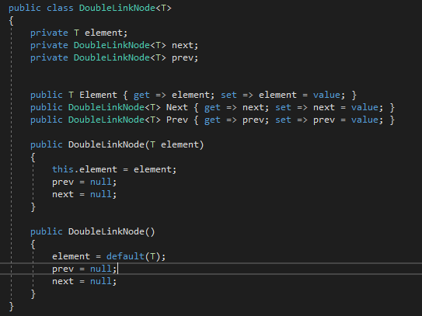
Changes to the node class

Slide 18
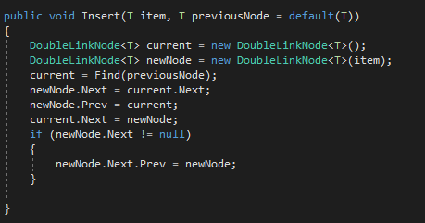
Changes to insert
We just need to point our new Node’s previousNode to our defined previousNode from the function parameter
We need to point the original next node’s prev back to the new node
NB! But only if the next node is actually a node!

Slide 19
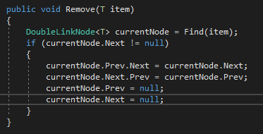
Changes to remove
No longer need to find previous node as a function
Built in
Find our item node
Link our previous node’s next to our next (bypasses us)
Link our next node’s prev to our prev
Null our own values

Slide 20
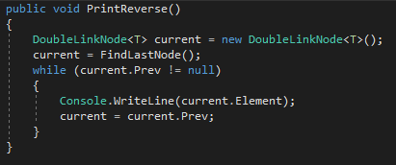
Printing in reverse
We find our last node
We traverse through prev links until we get to null
We print along the way

Slide 21
Circular linked lists
Last node points back to the header
1
Good for searching through a list multiple times
2
Just set header.Next = header in the constructor
3
Consider the implications of printing in a circular linked list
4

Slide 22
Other considerations
For object based Linked Lists, default(T) is null, so your header element will be pointing to null
This makes working with custom objects difficult
How would we fix this?

Slide 23
Simplifying list operations
Can only refer to a single list position at a time
1
Can create an iterator class that allows us to specify a range of values
2
Have pointers for start and end values in a range
3
Allows for more controlled access across the list’s values
4

Slide 24

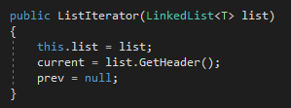
List iterator: pointers
Current is head
Prev is null
Starts at the header to move through list

Slide 25
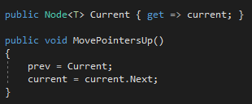
List iterator: moving through the list
Moves the current and prev pointers up the list
Has nothing to do with the list itself
Design pattern
Just makes access easier

Slide 26
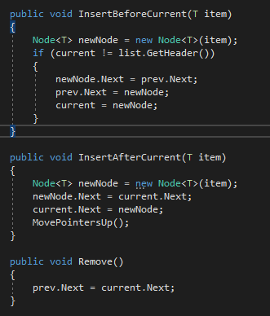
List iterator: easier insert and delete
No longer have to specify node positions
You just insert and delete in relation to the pointers
Delete removes the current pointed to node

Slide 27
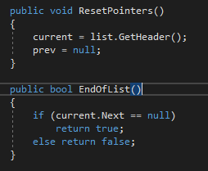
List iterator: resetting and end of list

Slide 28
Creating a linkedlist without a header
Important for object based linked lists
You can not have a header be a Node with a default element value if you’re using custom objects
Why?
How do we change our traditional LinkedList to avoid this?

